Slide 1

JAVASCRIPT
Subtitle

Slide 2
In this section, we will discuss:
Introduction to JavaScript
Javascript Datatype
Javascript Condition and Loop
JavaScript Array
JavaScript Function
Javascript DOM
Javascript BOM

Slide 3
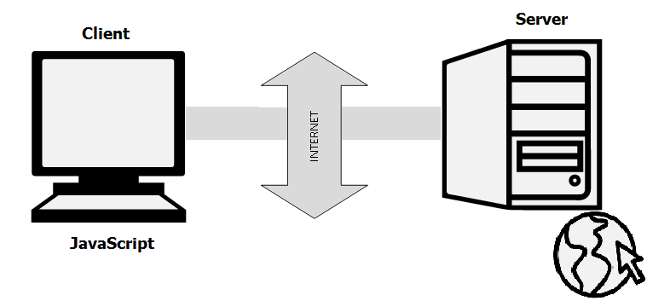
What is javascript
JavaScript is a very powerful client-side scripting language.
JavaScript is used mainly for enhancing the interaction of a user with the webpage.

Slide 4
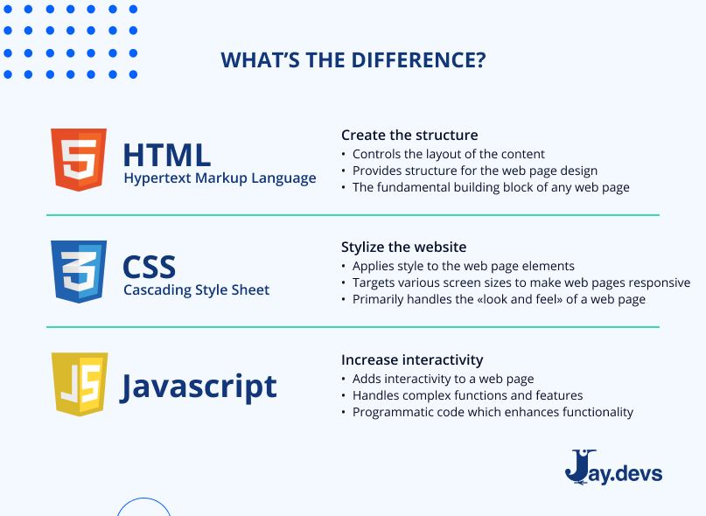
Why javascript
JavaScript offers lots of flexibility.
Mobile app development, desktop app development, and game development.
With javascript you can find tons of frameworks and libraries already developed, which can be used directly in web development.

Slide 5
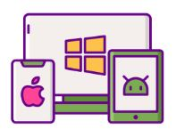
Javascript uses
JavaScript is used in various fields from the web to servers:
Web Applications
Mobile Applications
Web-based Games
Back-end Web Development

Slide 6
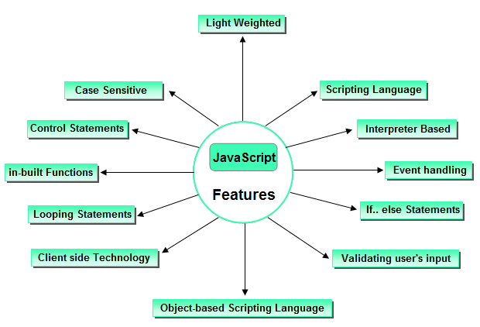
Features of JavaScript

Slide 7
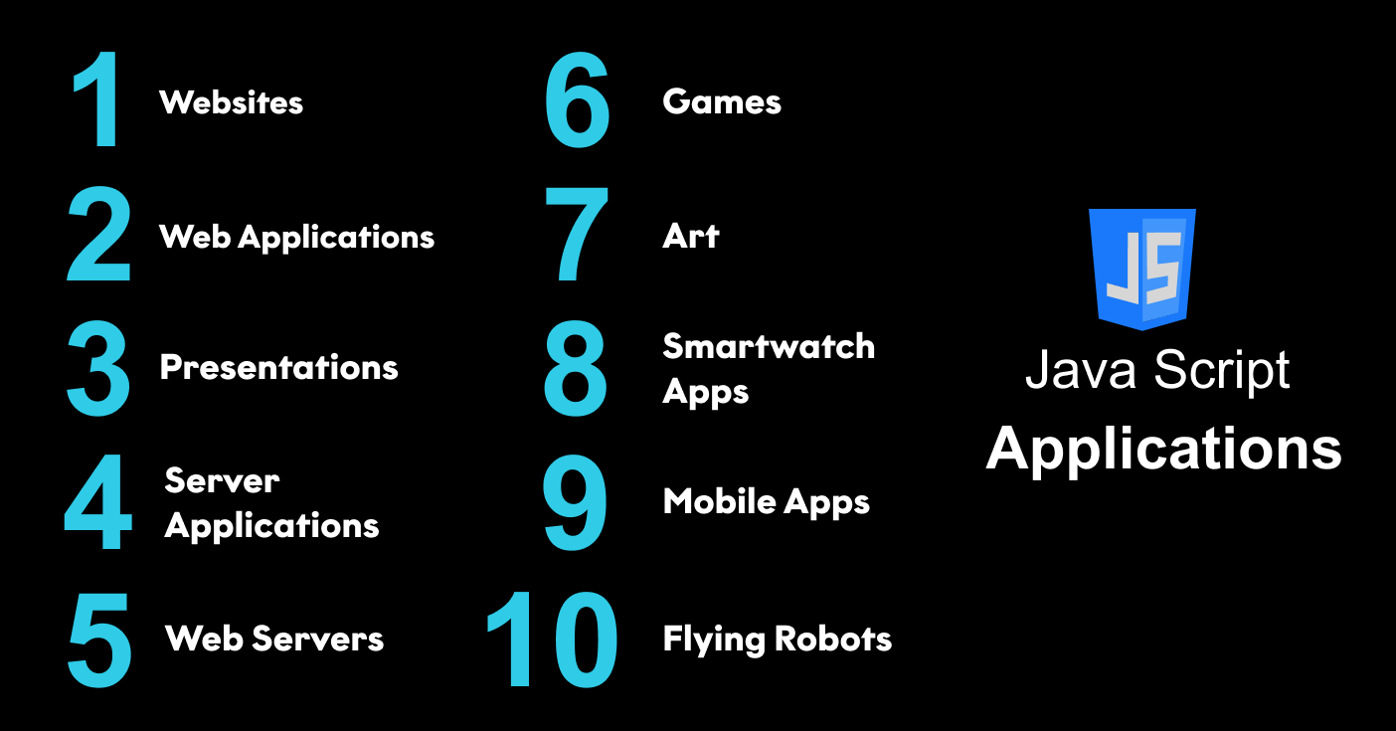
Applications of javascript
JavaScript is used to create interactive websites.
It is mainly used for:
Client-side validation,
Dynamic drop-down menus,
Displaying date and time,
Displaying pop-up windows and dialog boxes.
Displaying clocks etc.

Slide 8
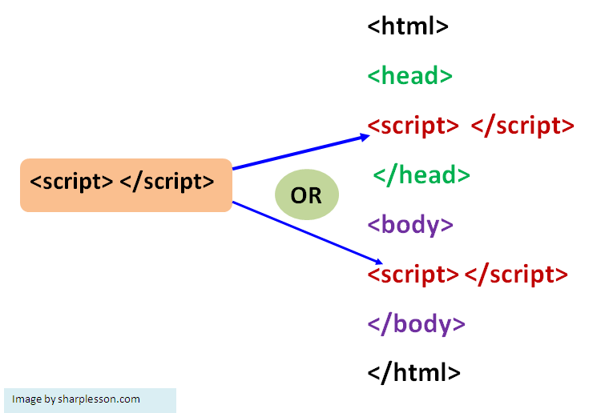
Javascript syntax
JavaScript provides 3 places to put the JavaScript code:
within body tag,
within head tag and
external JavaScript file.

Slide 9
Javascript_EXAMPle
<script type="text/javascript">
document.write("JavaScript is a simple");
</script>

Slide 10
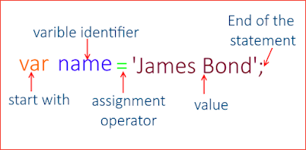
Javascript variables
Variables are used to store data, like string of text, numbers, etc.
The data or value stored in the variables can be set, updated, and retrieved whenever needed.
Example:
var name = "Peter Parker";
var age = 21;
var isMarried = false;

Slide 11
Javascript Datatypes
JavaScript is dynamic and loosely typed language. It means you don't require to specify a type of a variable.

Slide 12
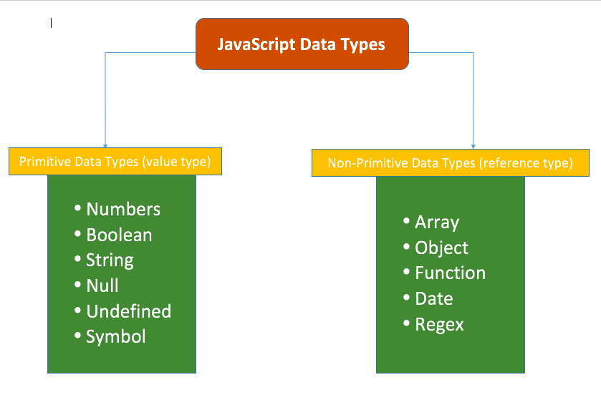
Datatypes types

Slide 13
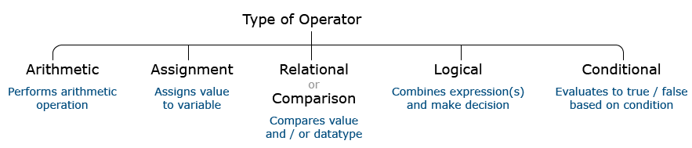
Javascript operators
An operator performs some operation on single or multiple operands (data value) and produces a result.
Syntax:
<Left operand> operator <right operand>
<Left operand> operator

Slide 14
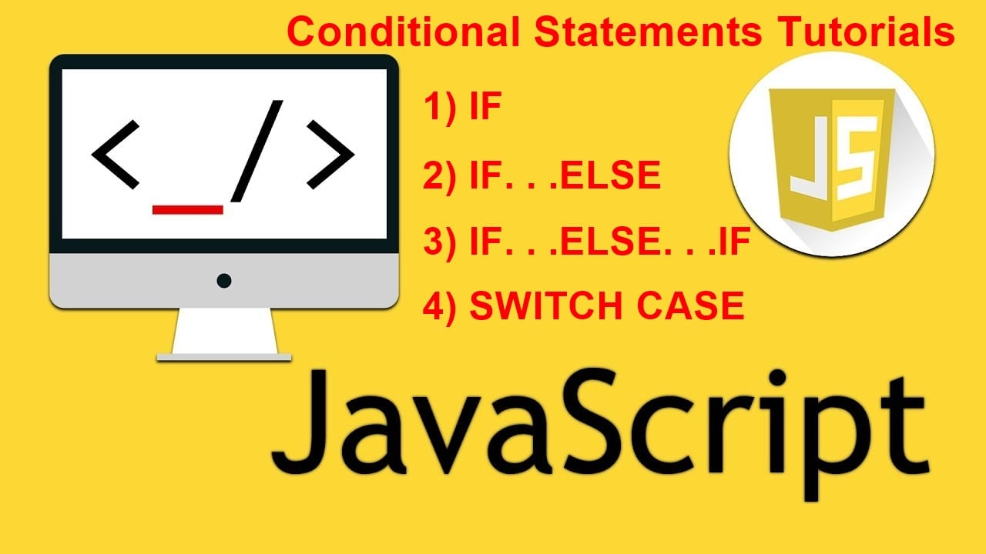
Conditional statements
Conditional statements control behavior in JavaScript and determine whether or not pieces of code can run.

Slide 15
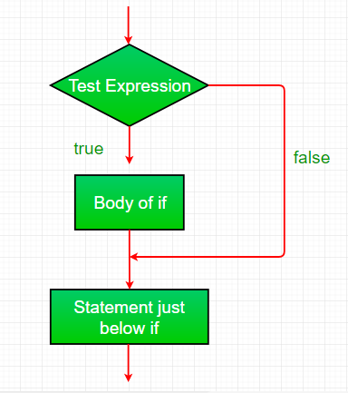
If
It evaluates the content only if expression is true.
Syntax:
if(expression)
{
//content to be evaluated
}

Slide 16
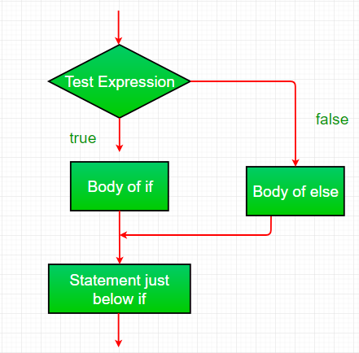
If else…
It evaluates the content whether condition is true of false.
Syntax
if(expression){
//content to be evaluated if condition is true
}
else{
//content to be evaluated if condition is false
}

Slide 17
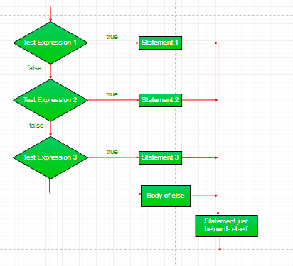
Else if
if(expression1){
//content to be evaluated if expression1 is true }
else if(expression2)
{ //content to be evaluated if expression2 is true }
else if(expression3)
{ //content to be evaluated if expression3 is true }
else{ //content to be evaluated if no expression is true }

Slide 18
Switch
The JavaScript switch statement is used to execute one code from multiple expressions.
It is just like else if statement that we have learned in previous page. But it is convenient than if..else..if because it can be used with numbers, characters etc.

Slide 19
Looping statements
The JavaScript loops are used to iterate the piece of code using for, while, do while or for-in loops.
There are four types of loops in JavaScript.
for loop
while loop
do-while loop
For-in loop

Slide 20
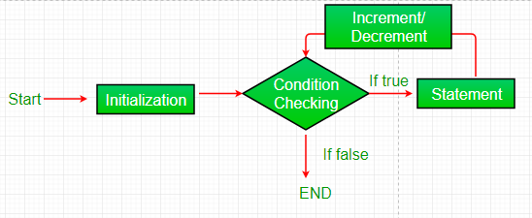
For loop
The JavaScript for loop iterates the elements for the fixed number of times. It should be used if number of iterations is known.
Syntax:
for (initialization; condition; increment)
{
code to be executed
}

Slide 21
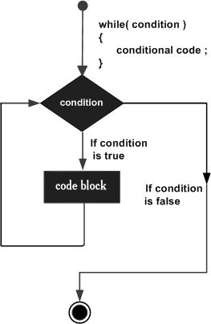
while loop
The JavaScript while loop iterates the elements for the infinite number of times. It should be used if number of iteration is not known.
Syntax:
while (condition)
{
code to be executed
}

Slide 22
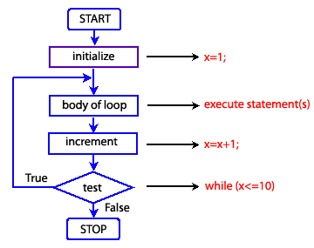
Do-while loop
The JavaScript do while loop iterates the elements for the infinite number of times like while loop. but, code is executed at least once whether condition is true or false.
Syntax:
do{
code to be executed
}while (condition);

Slide 23
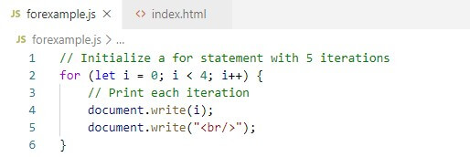
For in loop
The for..in loop provides a simpler way to iterate through the properties of an object.
Syntax:
for (variableName in Object)
{
statement(s)
}(condition

Slide 24
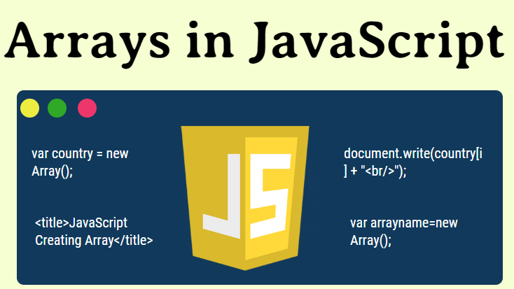
arrays
JavaScript array is an object that represents a collection of similar type of elements.
There are 3 ways to construct array in JavaScript
i. By array literal
ii. By creating instance of Array directly (using new keyword)
iii. By using an Array constructor (using new keyword)

Slide 25
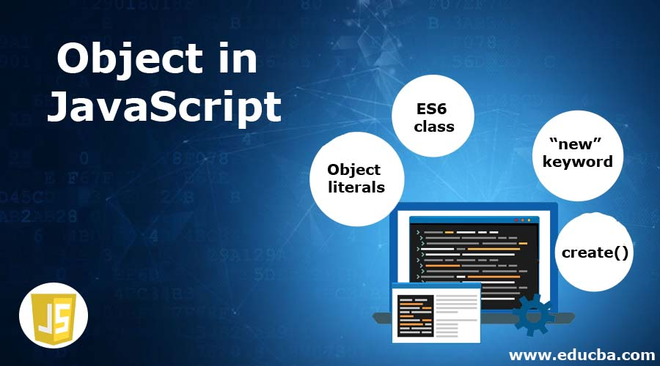
Js objects
A javaScript object is an entity having state and behavior. For example: car, pen, bike, chair, glass, keyboard, monitor etc.
JavaScript is an object-based language. Everything is an object in JavaScript.
JavaScript is template based not class based.

Slide 26
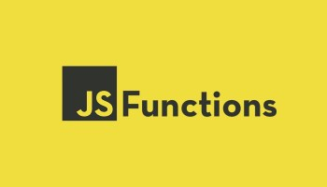
Js functions
A function is a block of code that performs a specific task.
Suppose you need to create a program to create a circle and color it. You can create two functions to solve this problem:
a function to draw the circle
a function to color the circle

Slide 27
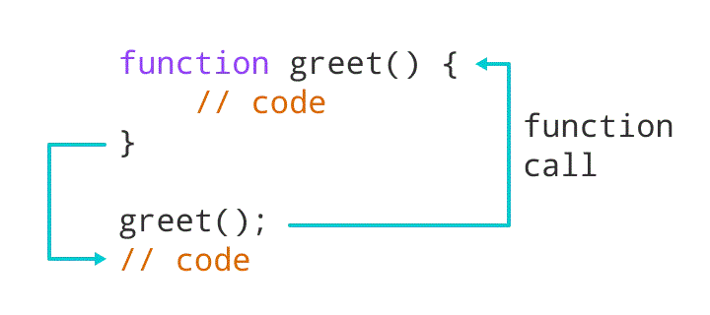
Js functions-call
A function is declared using the function keyword.
The basic rules of naming a function are similar to naming a variable.
The body of function is written within {}.
Syntax:
function nameOfFunction () {
// function body
}

Slide 28
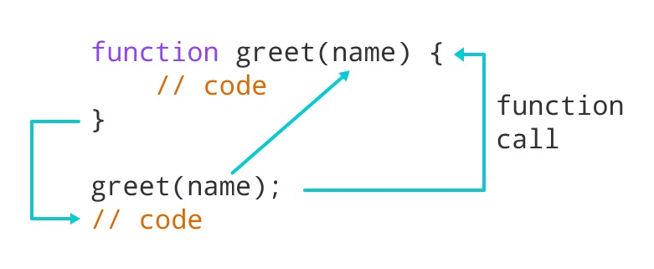
Js functions-parameters
A function can also be declared with parameters. A parameter is a value that is passed when declaring a function.

Slide 29
Js functions-return
The return statement can be used to return the value to a function call.
The return statement denotes that the function has ended. Any code after return is not executed.
If nothing is returned, the function returns an undefined value

Slide 30
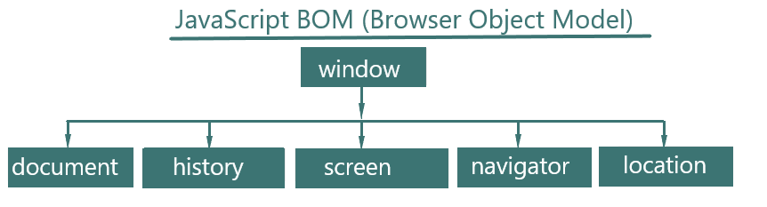
Browser object model

Slide 31
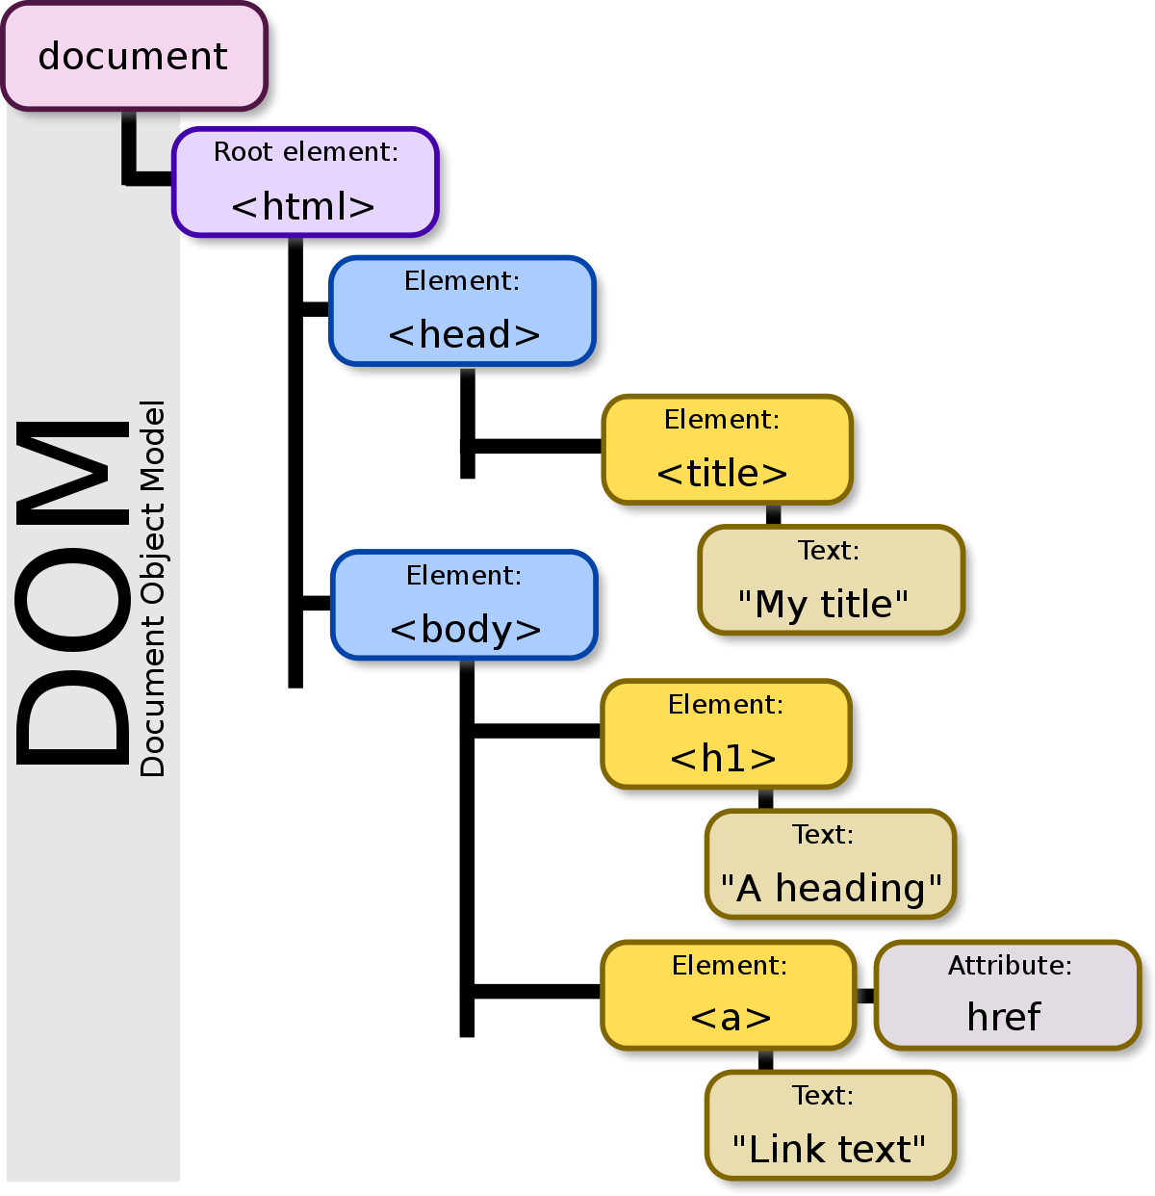
Document object model
JavaScript can access all the elements in a webpage making
use of Document Object Model (DOM). In fact, the web browser
creates a DOM of the webpage when the page is loaded.

Slide 32
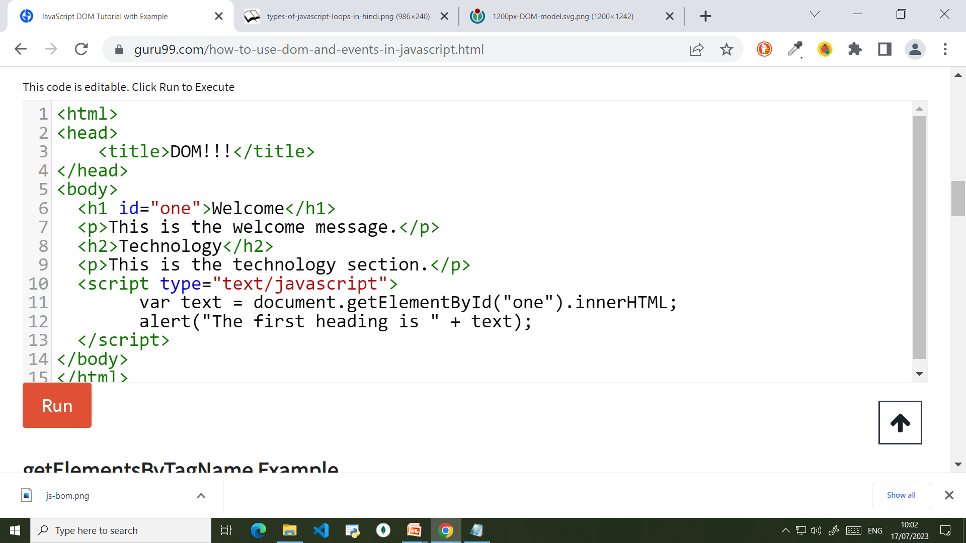
Dom example

